Slide 1

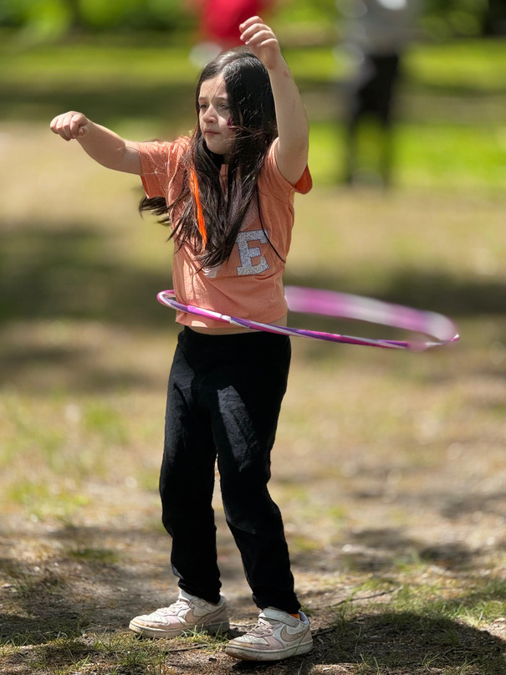
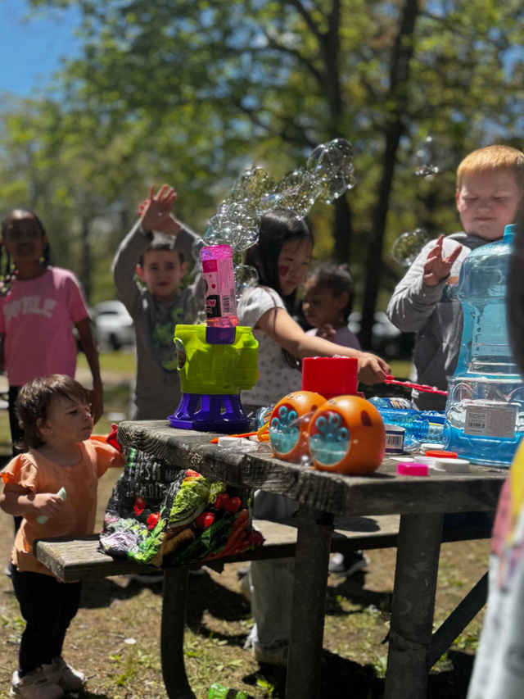
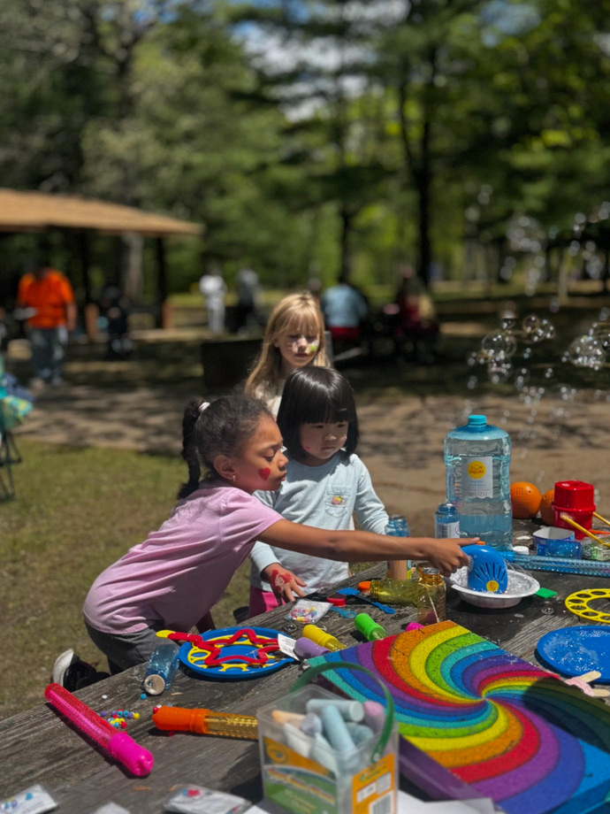

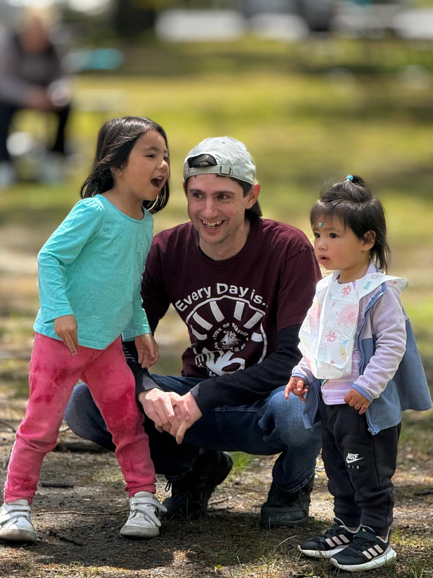
MISSION WALK
& PICNIC
FUN FOR ALL AGES!
SATURDAY, MAY 9
BELMONT LAKE STATE PARK
ACTIVITIES:
5K Walk
Crafts
Line Dancing
Kickball
Tai Chi
Paddleboating ($20/hr)
Food
Games
Opening Worship
Dog-friendly event
Register with our church at: LIEdistrict.com/MissionWalk

